Slide 1
Flux Training
Emanuele Della Valle
Prof. @ Politecnico di Milano
Founder & Partner @ Quantia Consulting
Marco Balduini
Founder & CEO @ Quantia Consulting
Riccardo Tommasini
Prof. @ INSA Lyon (France)

Slide 2
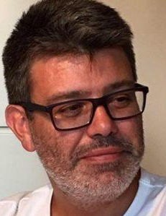
Emanuele Della Valle, PhD
Associate Professor | Politecnico di Milano
Founder & Partner | Quantia Consulting
Expert in semantic technologies and stream computing
Brander of stream reasoning: an approach to master the velocity and variety dimension of Big Data blending stream processing and AI
+20 years experience in innovation and research projects
Contact
emanuele.dellavalle@quantiaconsulting.com
@manudellavalle
http://emanueledellavalle.org
https://www.quantiaconsulting.com

Slide 3
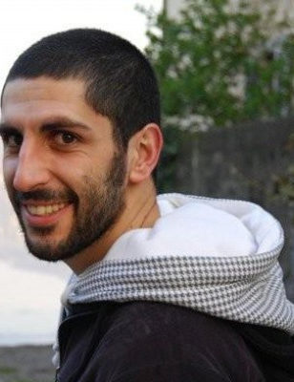
Marco Balduini, PhD
Founder & CEO | Quantia Consulting
Expert in data processing, data integration and data science technologies
Main contributor of the C-SPARQL Engine, author of Streaming Linked Data framework and FraPPE ontology
~10 years experience in innovation and research projects
Contact
marco.balduini@quantiaconsulting.com
@balducci85
https://marcobalduini.com/
https://www.quantiaconsulting.com

Slide 4
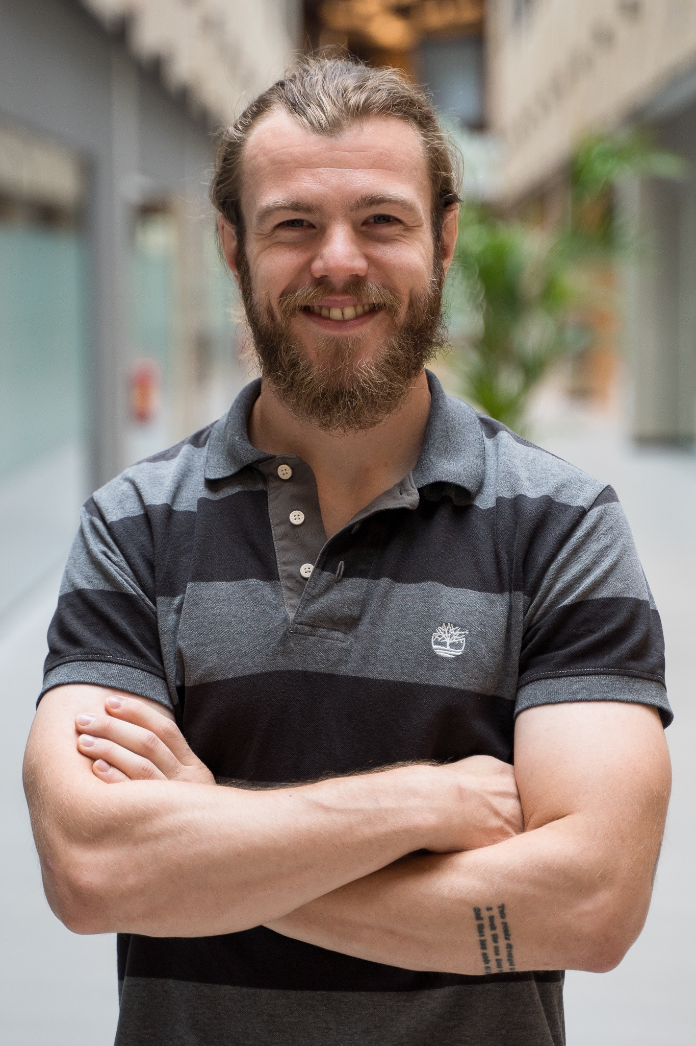
Riccardo Tommasini, PhD
Associate Professor | INSA Lyon (France)
Expert in graph and streaming data processing, data integration and semantic technologies
Main contributor of the RSP-QL stack Engine, author of VoCaLS ontology
~5 years experience in innovation and research projects
Contact
riccardo.tommasini@quantiaconsulting.com
@rictomm
https://riccardotommasini.com/

Slide 5
Flux Training
Emanuele Della Valle
Prof. @ Politecnico di Milano
Founder & Partner @ Quantia Consulting
Marco Balduini
Founder & CEO @ Quantia Consulting
Riccardo Tommasini
Prof. @ INSA Lyon (France)

